Slide 1
AI and AWS
CITS5503

Slide 2
https://www.youtube.com/shorts/uBIYhmqhJYo

Slide 3
Is it true that AI is taking over human jobs, becoming the dominant form of intelligence on Earth, and potentially taking control of the planet?

Slide 4
What is AI?
AI
AI: is about to make machines act like humans.
Machine learning: is a subset of AI that is used to make machines learn from data.
Deep learning: is a subset of machine learning that enhances the automation of training AI models.
Machine
learning
Deep
Learning

Slide 5
Question Answering
Text
Sentiment Analysis
Images
Information extraction
Training
Model
Adaptation
Speech
Image caption
Data
Object recognition
3D sginals
Instruction following

Slide 6
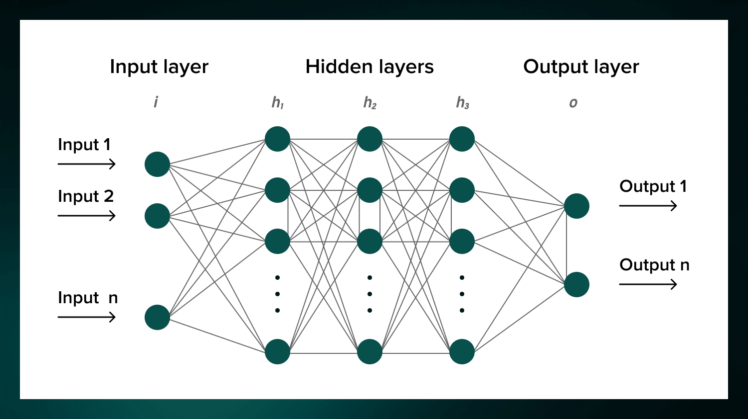
Neuronal Network Infrastructure

Slide 7
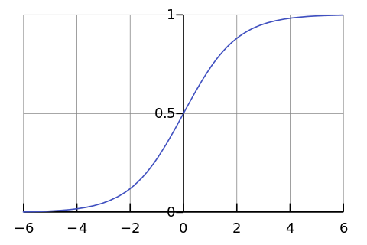
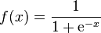
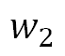
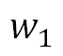
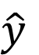
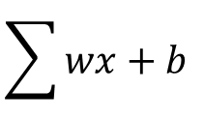
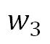
Perceptron (Single node neural network)
Activation Function
x₁
$$w_{1}$$
x₂
$$w_{2}$$
$$\sum{wx+b}$$
$$\hat{y}$$
$$w_{3}$$
x₃
Error

Slide 8
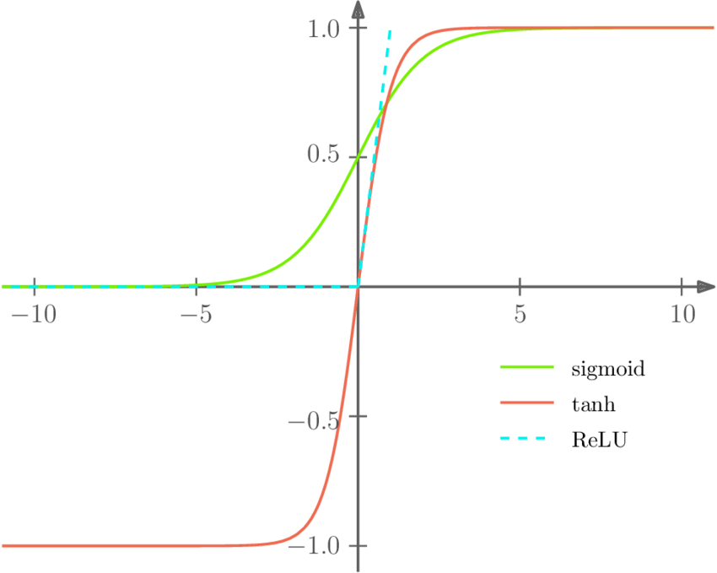
Activation Function

Slide 9
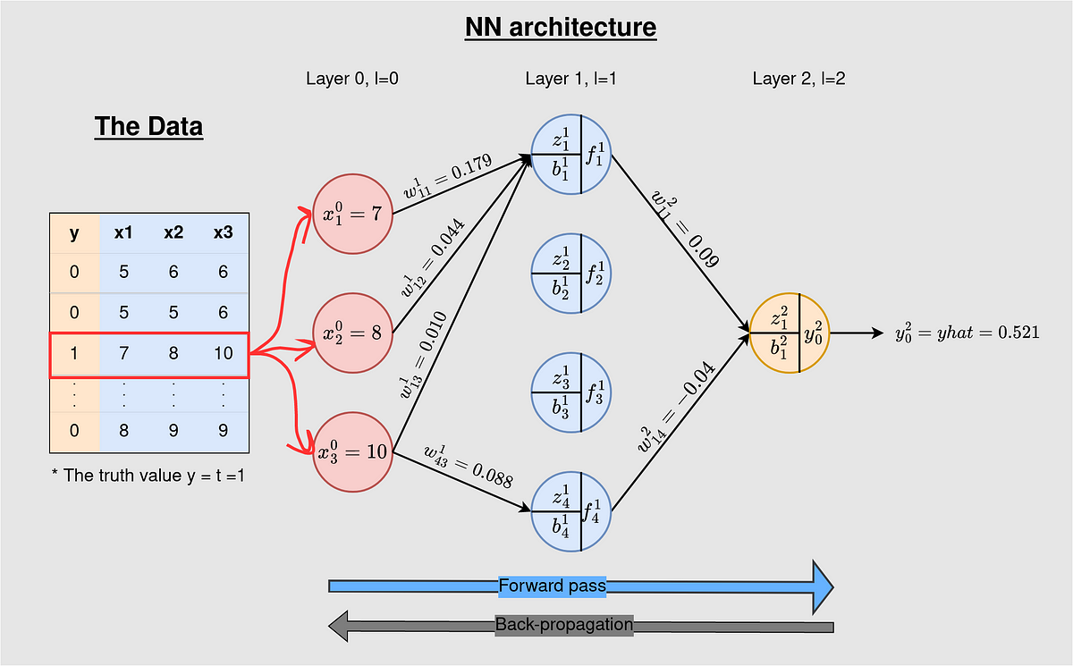
Back-Propagation Work in Neural Networks

Slide 10
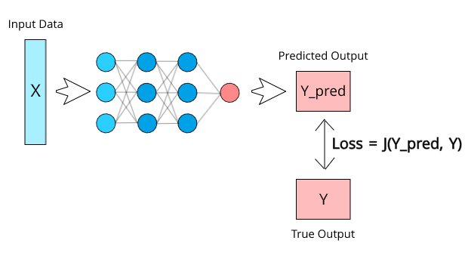
Calculating the Loss

Slide 11
Metrics for Monitoring the Performance of the Model
Accuracy: Measure the percentage of correctly classified instances.
Mean Absolute Error (MAE): Commonly used for regression tasks, it measures the average absolute difference between predicted and actual values.
Mean Squared Error (MSE): Another regression metric, it measures the average squared difference between predicted and actual values, giving higher weight to larger errors.
Cross-Validation Scores: Assess model performance on multiple subsets of the data to check for overfitting and assess generalization.

Slide 12
Bayesian Algorithm
A Classification Technique Support By Bayes’ Theorem
P(Hypothesis)⋅P(Evidence∣Hypothesis)​
P(Hypothesis∣Evidence)=
_______________________________
P(Evidence)
The email spam detection scenario: What at the probability that the email is scam if it has the word Free?

Slide 13
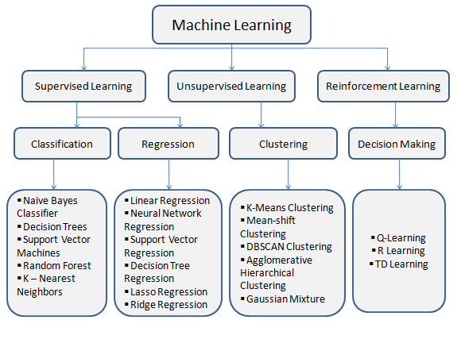
The types of machine learning
Supervised learning.
Unsupervised learning.
Reinforcement learning.
Everything you need to know about Machine Learning
:https://www.analyticsvidhya.com/blog/2021/03/
everything-you-need-to-know-about-machine-learning/

Slide 14
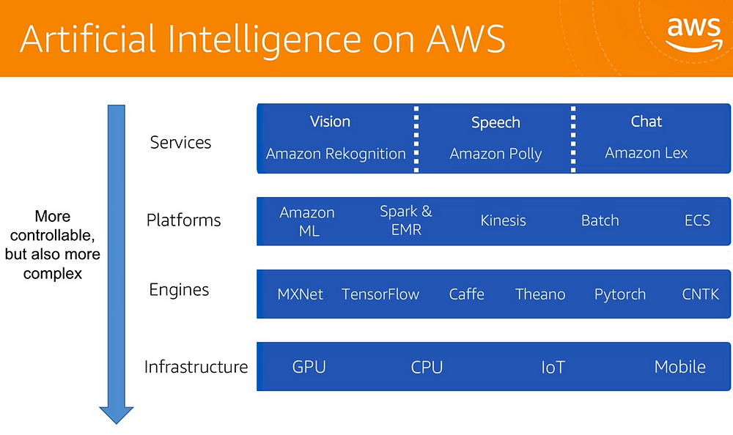
AWS’s applications and platforms

Slide 15

Amazon Comprehend
Analyze any text and provides information on:
Entities – people, places, locations
Key phrases – pertinent to the subject of the document
Language - detect the language of the text
Sentiment – sentiment analysis of the text
Topic Modelling - Analyze a corpus of documents and find common themes

Slide 16
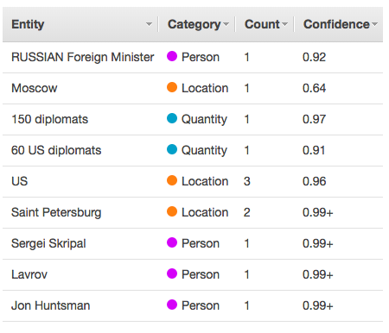
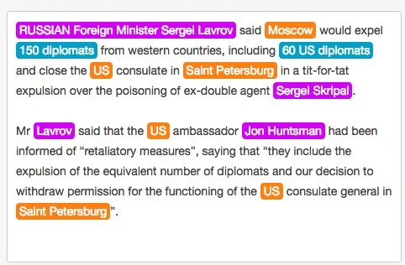
Analysis of news item

Slide 17
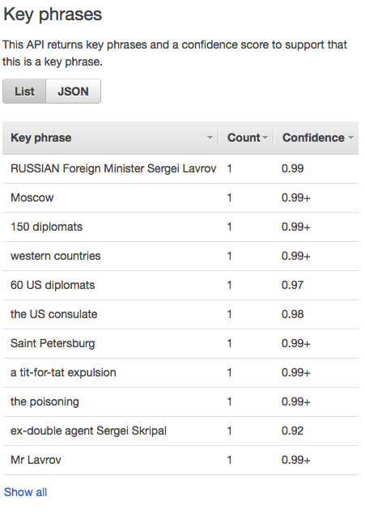
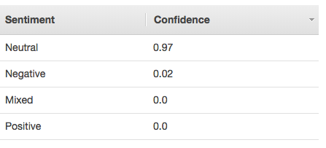
Key phrases and sentiment

Slide 18
In code
import boto3
import json
comprehend = boto3.client(service_name='comprehend', region_name='us-east-1')
text = "I am so very happy that it is raining today in Seattle"
print('Calling DetectSentiment')
print(json.dumps(comprehend.detect_sentiment(Text=text, LanguageCode='en'), sort_keys=True, indent=4))
print('End of DetectSentiment\n')

Slide 19
Amazon Rekognition
Image and Video recognition services
Searchable images and video libraries
Face-based user verification
Sentiment and demographic analysis – happy, sad, gender
Facial recognition
Unsafe content detection
Celebrity recognition
Text detection

Slide 20
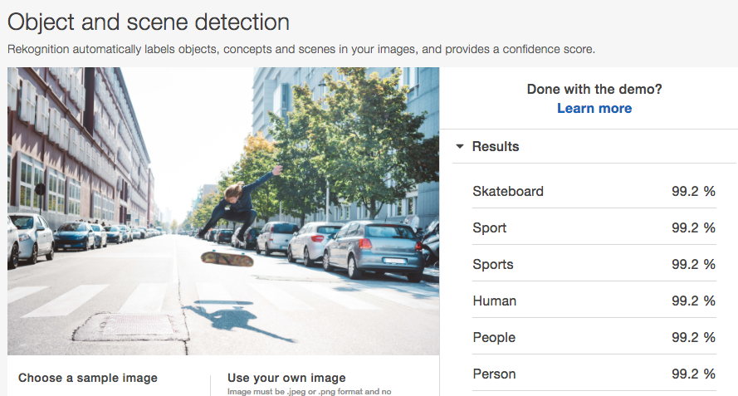
Object and scene detection

Slide 21
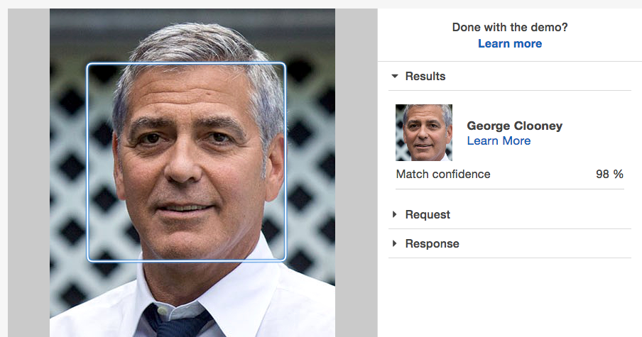
Celebrity Recognition

Slide 22
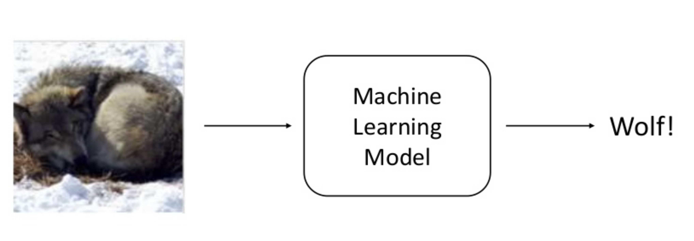
Wolf vs Husky
Classifier to recognize images as either Wolf or Husky
Sameer Singh UC Irvine https://www.slideshare.net/0xdata/explaining-blackbox-machine-learning-predictions

Slide 23
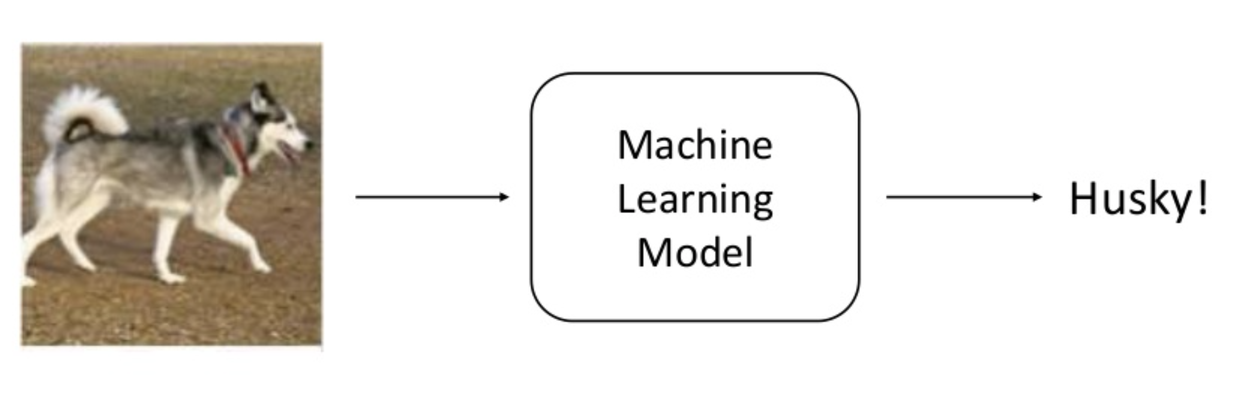
Husky

Slide 24
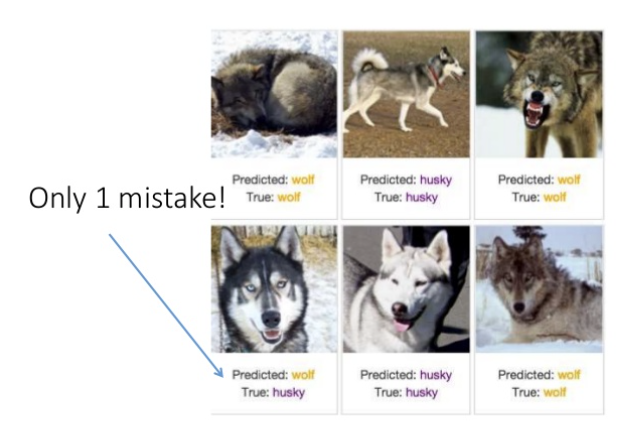
Predictions

Slide 25
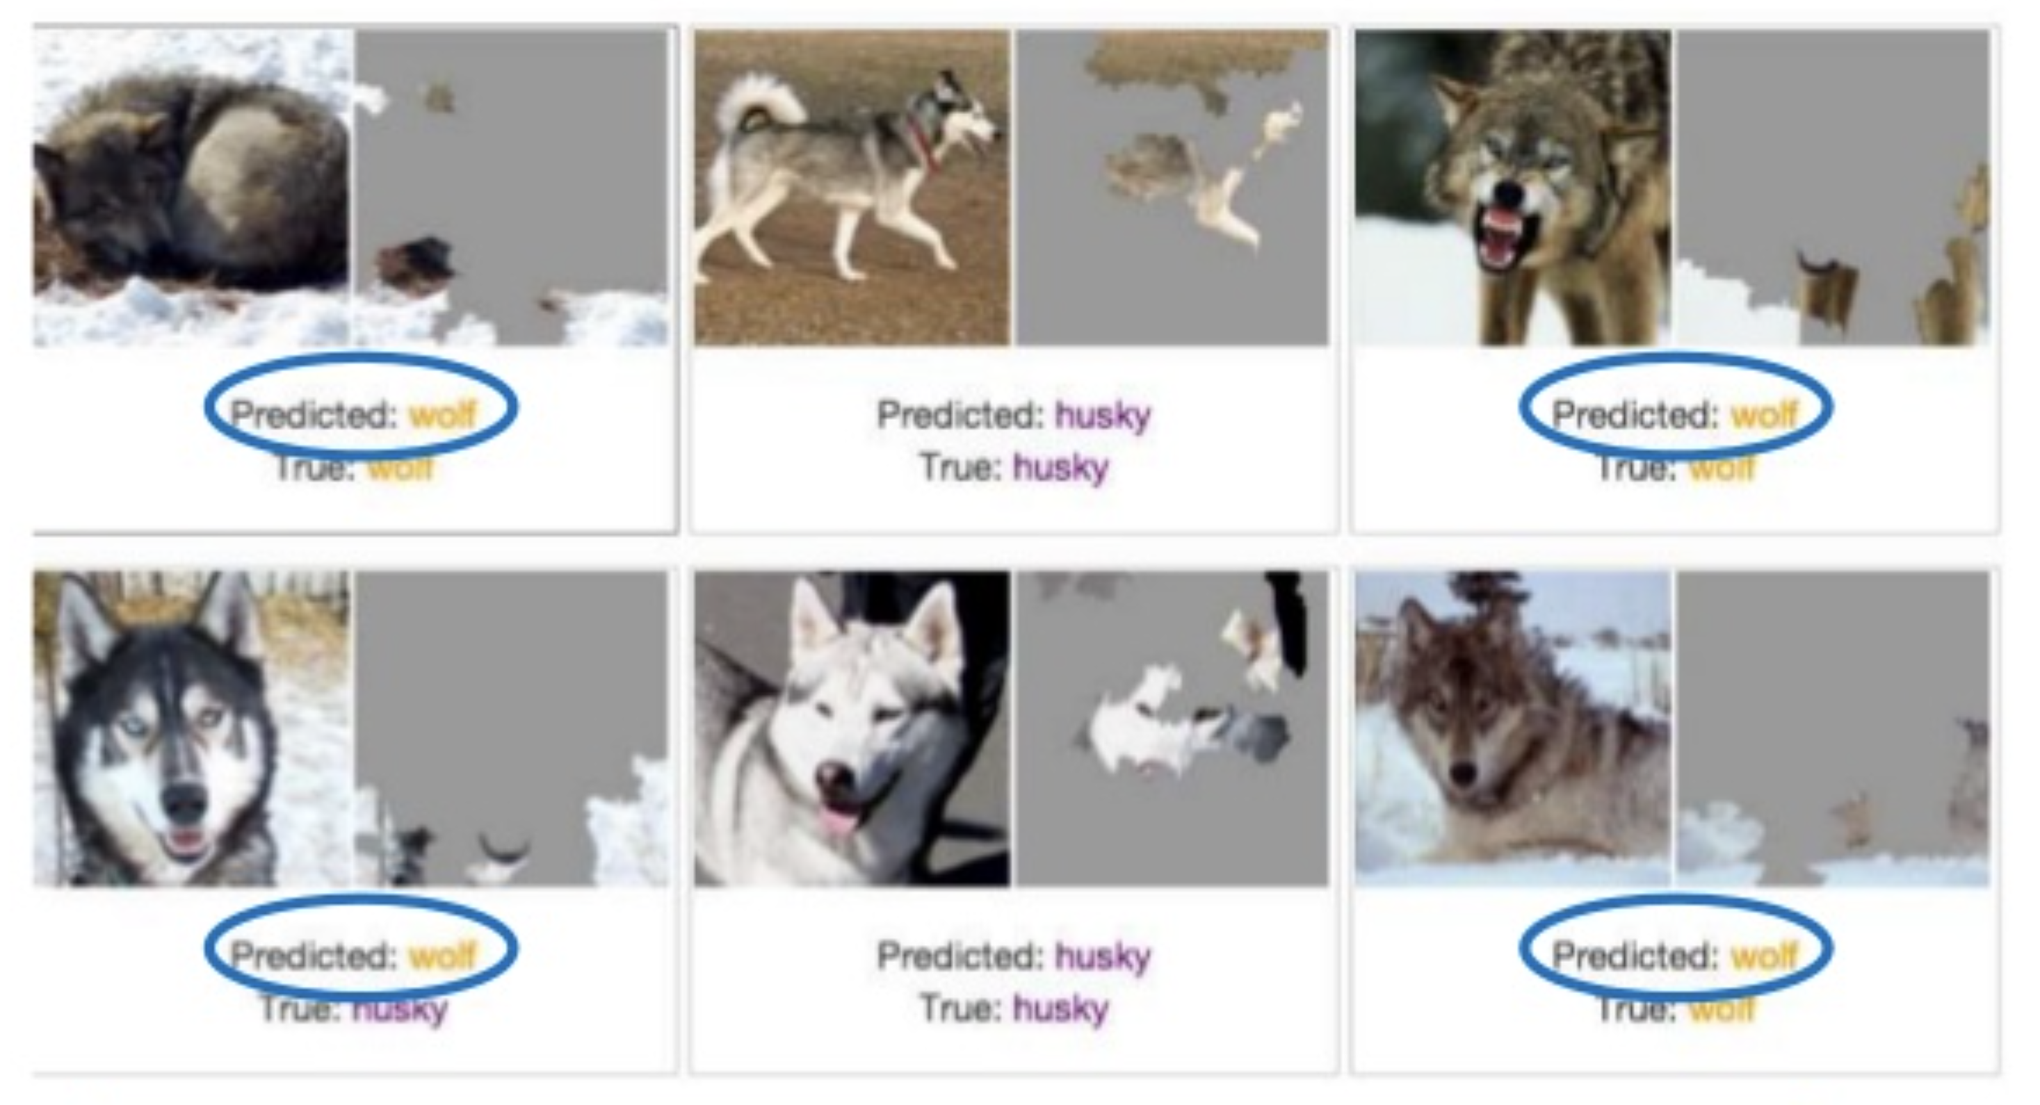
Model was recognizing snow!

Slide 26
Amazon Lex
Based on the same technology as Alexa
Built on Natural Language Understanding (NLU) and Automatic Speech Recognition (ASR)
Also needs to action commands
Similar technology to HomePod (Siri) and Google Home (Google Assistant)
Can use it to create Chatbots

Slide 27
Chatbots
Conversational software with varying levels of artificial intelligence
ELIZA MIT Joseph Weizenbaum 1966 – imitated a psychotherapist
PARRY Kenneth Colby 1972 - imitated a patient with schizophrenia
Jabberwacky Rollo Carpenter 1988
ALICE (Artificial Linguistic Internet Computer Entity)
Siri, Google Now, Cortana, Alexa, etc

Slide 28
Chatbot approaches
Retrieval based (also rules based)
Use a heuristic to access predefined responses
Heuristic can be simple pattern matching or machine learning classification
Generative model
Generate new responses from scratch
Long vs short conversations
short is obviously easier
Open domain vs closed domain
restricting topic is easier

Slide 29
Common problems
Babbling
Coherent personality
Incorporating context
linguistic and physical
Evaluating models
Hard to do automatically
Intention and diversity
Humans produce diverse responses with intention – hard with generative systems (Google’s early version of chat bot tended to respond with “I love you”

Slide 30
Rule-based bots
No AI
Specific tasks handled
Recognizes triggers
Job of scripts are to:
Clean and normalize text
Correct spelling
Convert idioms
Remove junk words
Expand abbreviations
Identify triggers
Scripting environments: SuperScript, botpress using Universal Message Markdown, etc

Slide 31
AI-based bots
Can learn through conversations
So can be trained
Problem if this is done unsupervised as in Microsoft’s Tay Twitter bot that went horribly wrong
AIML 2.0 scripting language mostly rule-based but can learn categorical information
Possible to create deep neural network-based chat bots that learn conversations from databases of conversations

Slide 32
Turing test
Alan Turing 1950: test a machine’s ability to exhibit intelligent behavior indistinguishable from a human’s
Turing test involves a tester sending questions to a human female and male and the tester asked to distinguish which person was which. A computer replaces one of the subjects and the test is repeated. Aim is for the guesses of male/female should be the same in the computer case.
Chatbots have been getting better at finessing the competitions like the Loebner prize – but basically still “cheating” https://theconversation.com/a-computer-beating-humans-and-passing-turings-test-wasnt-a-fair-fight-27367

Slide 33
Back to Lex
Create a bot using a Blueprint:
Intent – what the bot is programmed to do on the receipt of an utterance – example intents are:
OrderFlowers, BookTrip, ScheduleAppointment
Slot types
Roses, Lilies, Tulips
Slots
PickupTime, FlowerType, PickupDate
Utterances
”I would like to order some flowers”
Prompts
spoken prompts for the slots “What type of flowers would you like to order?”

Slide 34
New skills and deployment
Alexa can be trained with new skills, intents etc
Deployment to:
Facebook
Kik
Slack
Mobile applications

Slide 35
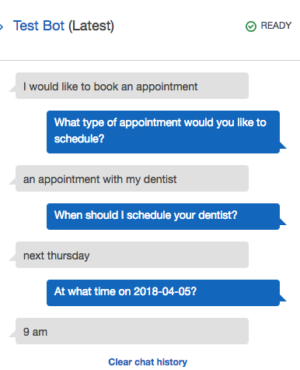
Example Bot
ScheduleAppointment
Intents:
MakeAppointment
Slot types
Appointment Type
Appointment Date
Appointment Time
Utterances
Book a {AppointmentType}
I would like to book an appointment

Slide 36
Alternatives
ChatGPT
T5
SeamlessM4T
Llama
And more … see Hugging face repository: Models - Hugging Face

Slide 37
T5, or Text-to-Text Transfer Transformer, “is a Transformer based architecture that uses a text-to-text approach. Every task – including translation, question answering, and classification – is cast as feeding the model text as input and training it to generate some target text.”
Reference “https://arxiv.org/abs/1910.10683v3”

Slide 38
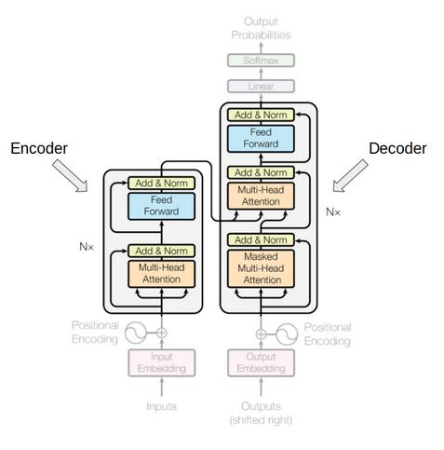
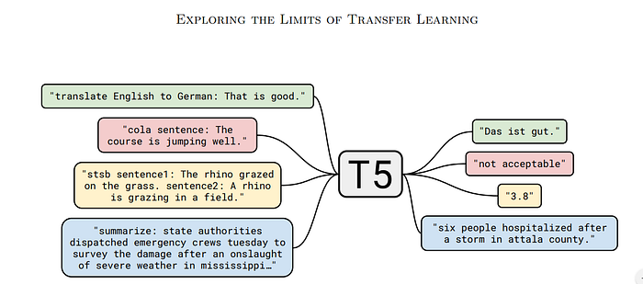
Googles T5 Transformer

Slide 39
Example of Using AWS resource such as SageMaker Jumpstart to fine-tuning for the FLAN T5
Fine-tuning is a technique that is used to take a pre-trained model and adapt it to a new task.
Preparing your Environment
Data Preparation
Setting up the Fine-Tuning Pipeline
Fine-Tuning
Evaluation
Inference

Slide 40
Preparing your Environment
Hardware and Software Requirements: Ensure you have access to a suitable environment for fine-tuning.
Amazon EC2 Instances:
Amazon S3:
Amazon EBS:
Amazon Elastic Inference: Elastic Inference allows you to attach low-cost GPU-powered inference acceleration to your EC2 instances.
Amazon CloudWatch: CloudWatch provides monitoring and logging
Install Required Libraries: Use Pip to install the necessary Python libraries. Common libraries for machine learning include:
NumPy and pandas.
Matplotlib and Seaborn.
Scikit-learn.
TensorFlow or PyTorch.
Setup configuration:
AWS region
configure sageMaker session using boto3
Select a T5 Model: Choose a pre-trained T5 model that suits your task. (e.g., "t5-small," "t5-base," "t5-large," or "t5-3b").

Slide 41
Data Preparation
Collect and Prepare Data:
Labelled
Not labelled
Data Preprocessing:
Tokenize
Normalized
Missing data

Slide 42
Setting up the Fine-Tuning Pipeline
Choose a Framework
PyTorch
TensorFlow
Load the Pre-trained T5 Model
Hugging
Github
Data Loader : dataset should be divided into three
Training : for training model.
Validation: for fine-tuning model.
Testing: for testing the performance of the model.

Slide 43
Fine-Tuning
Define Training Hyperparameters: Set hyperparameters
like batch size: the number of training samples utilized in one forward and backward
learning rate: controls the step size or rate at which a machine learning model updates its internal parameters during training.
number of training epochs: pass through the entire training dataset.
and evaluation metrics: assess the quality of a machine learning model's predictions
These values depend on your specific task and dataset.
Loss Function: Define a loss function that calculates the error between model predictions and ground truth.
Optimizer: Choose an optimizer such as Adam or RMSprop to update the model's weights during training.
Training Loop: Implement a training loop that iterates through your dataset.
Validation: Periodically evaluate your model on a validation dataset to check its performance during training.
Use fit method:

Slide 44
Evaluation
Test Data: evaluate your fine-tuned model on a separate test dataset.
Metrics: Calculate and report relevant evaluation metrics for your specific task.
Accuracy
Loss
Monitoring: Continuously monitor your training and evalating process.
Debugging: If your model isn't performing as expected, check your data, preprocessing, and model architecture for issues.

Slide 45
Inference
Deployment: If you intend to deploy your fine-tuned model for real-world applications, set up an inference pipeline. This may involve creating an API using frameworks.
Is it possible to fine-tuning T5 XL with Amazon SageMaker?
Yes, you can find all the step in the following link: Here

Slide 46
Alternatively…
MILABOT
Serban et al (2017) A deep reinforcement learning chatbot (https://arxiv.org/pdf/1709.02349.pdf)
Uses an ensemble approach including:
Rules-based: Alicebot, Elizabot, Initiatorbot, Storybot, Evibot, BoWMovies
Retrieval-based neural networks:
VHRED models (VHREDRedditNews, VHREDSubtitles, etc)
SkipThought Vector Models
Search engine-based neural networks
Generation-based neural networks

Slide 47
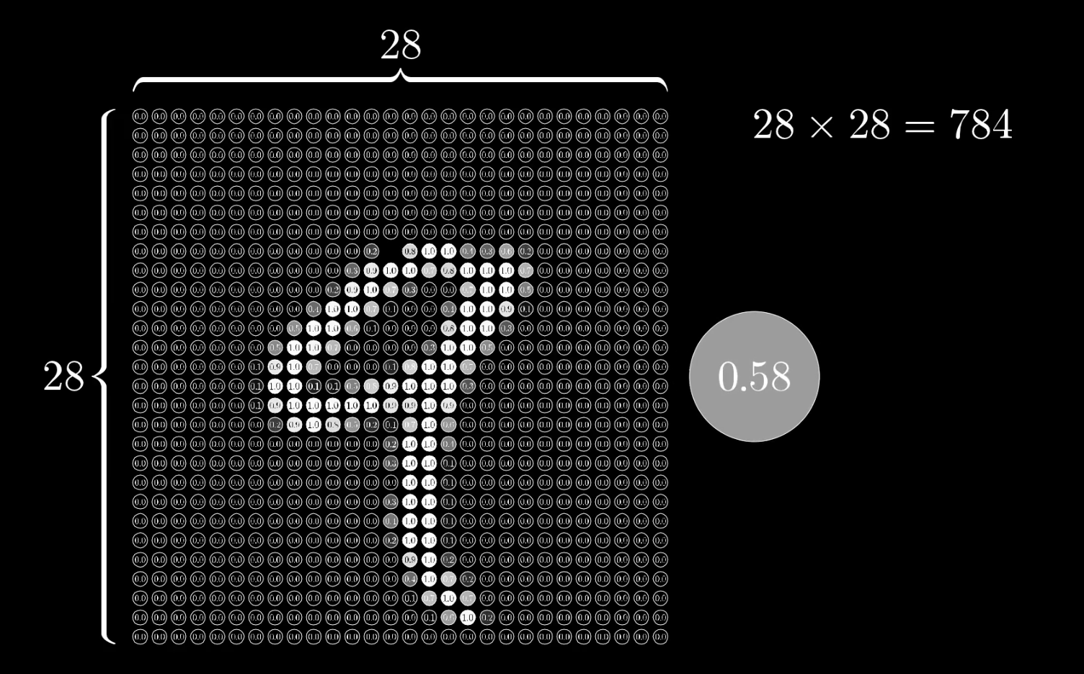
Digit Classification
Each handwritten number is captured as a 28 x 28 pixel image with a grayscale number for each pixel
Data sourced from MNIST images from Grant Sanderson (https://www.youtube.com/channel/UCYO_jab_esuFRV4b17AJtAw)

Slide 48
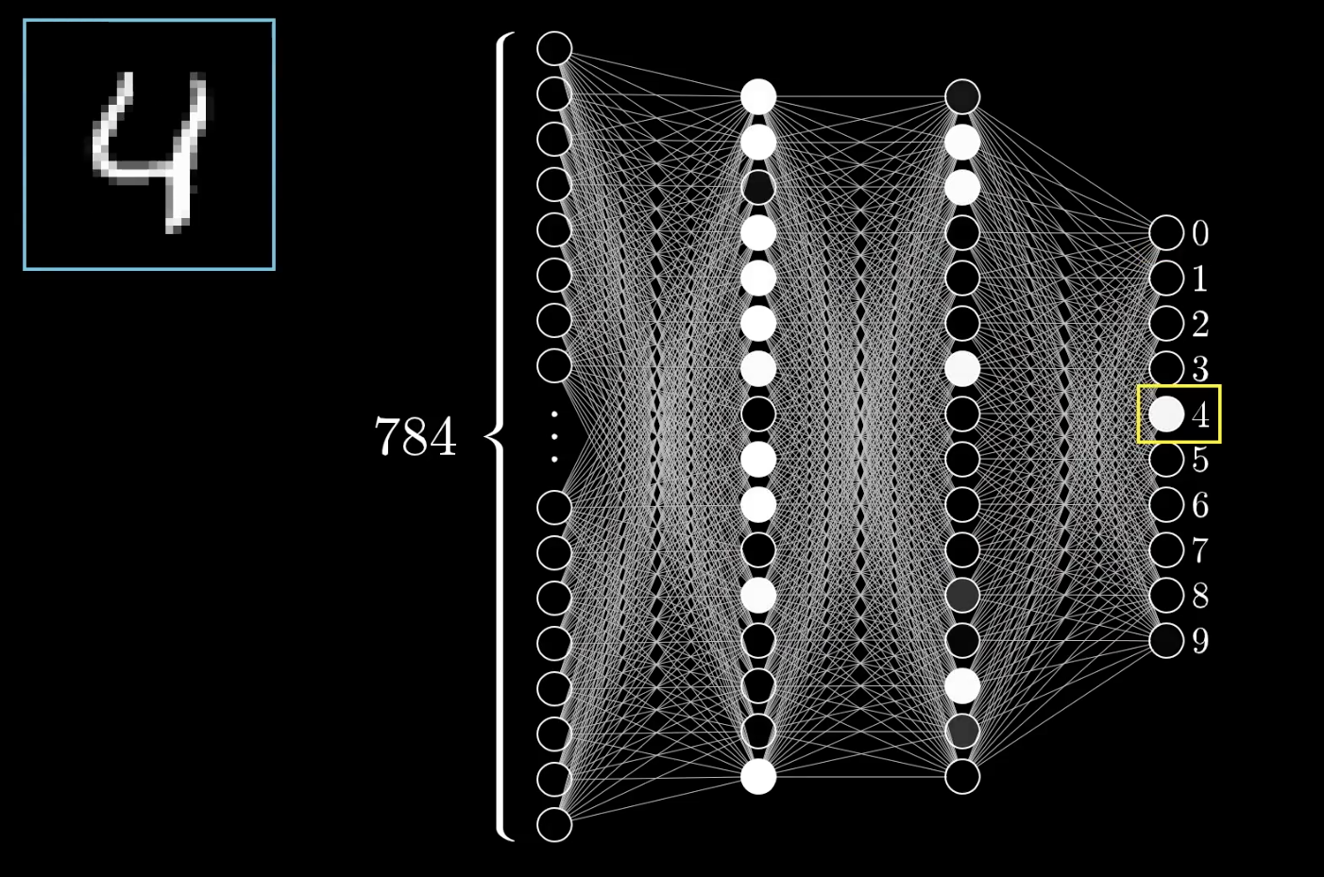
4 layer neural network
4 Layer neural network
Input layer
2 hidden layers
1 output layer
784 inputs for each pixel of a digit image
10 outputs – range of possible numbers

Slide 49
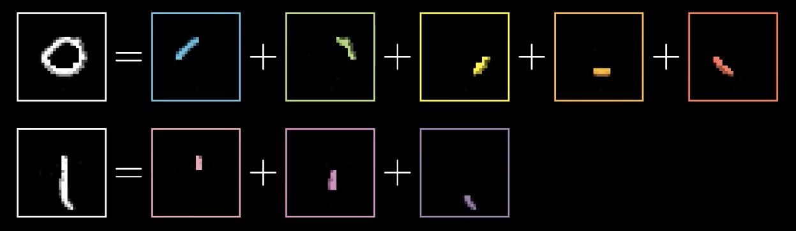
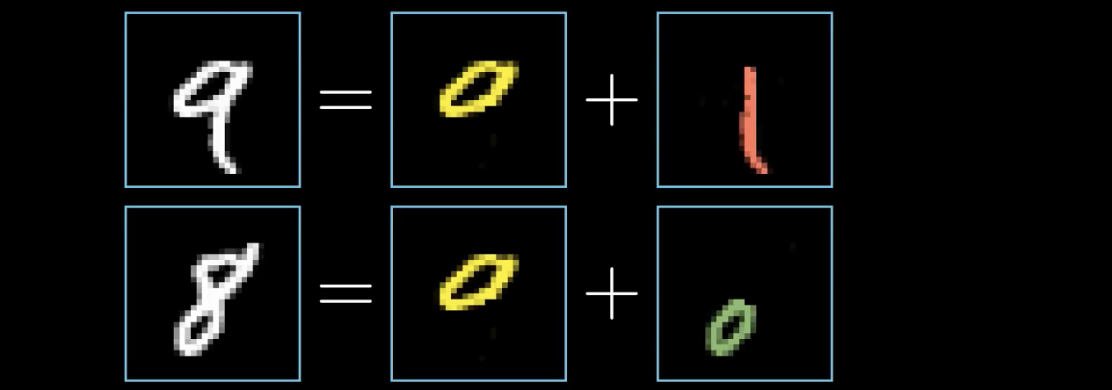
What is each layer recognizing?
Ideally, first hidden layer would recognise segments of lines
2nd hidden layer would recognise combined segments

Slide 50
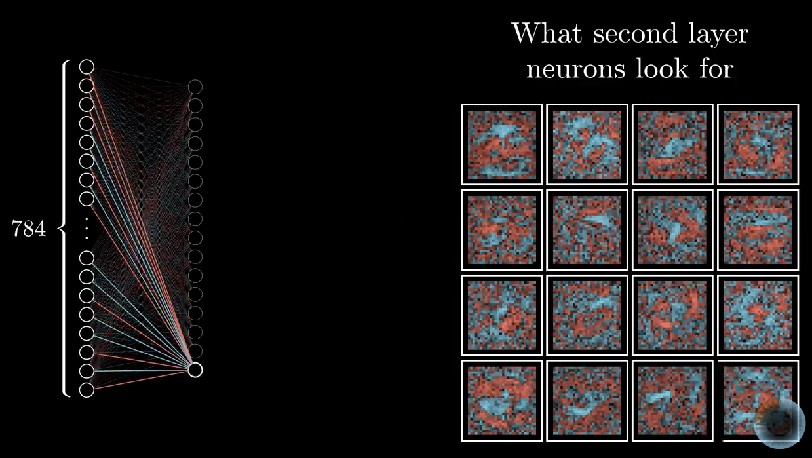
Visualising weights and biases
Expressed as a heat map, weights and biases show “random noise” instead of specific features
More specific deep neural networks can be trained to recognize segments – not this one

Slide 51
Random noise can be interpreted as a number
Neural networks of this type can’t say – “I don’t know”
Turns out that even sophisticated neural networks are subject to “adverserial input”

Slide 52
Amazon SageMaker
Environment for carrying out machine learning tasks
Based on Jupyter notebook software that mixes text, visualisations and the ability to execute live code
SageMaker will create environments – machines and containers to run the code specified in Jupyter
SageMaker consists of a Jupyter server and various frameworks and support for built-in algorithms
Linear, XGBoost, K-Means, Sequence to Sequence, DeepAR Forecasting, etc

Slide 53
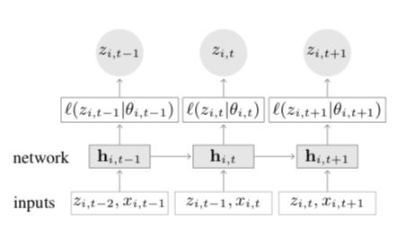
DeepAR Temperature Time Series
DeepAR uses Long short-term memory (LSTM)-based Recurrent Neural Network (RNN)
more info: https://arxiv.org/pdf/1704.04110.pdf

Slide 54
RNN and LSTMs
A
RNN has units that process sequential information in a sequential way with memory
[A] Repeating module in a standard RNN – single layer
[B] Repeating module in LSTM – 4 layers
B

Slide 55
Using DeepAR to predict temperature
Dataset global average temperature
Results are based on
41,811 monthly time series with 16,130,972 observations and
41,918 daily time series with 409,084,189 observations
Consists of
Date Number Year Month Day Day of Year Anomaly
1880.001 1880 1 1 1 -0.808
1880.004 1880 1 2 2 -0.670
Temperatures are reported as delta of 1951-1980 average (8.68°C).

Slide 56
Processing
Read in data and put into arrays
Plot of data
Create json files for training and upload to S3
Create a session to train data
estimator = sagemaker.estimator.Estimator(
sagemaker_session=sagemaker_session,
image_name=image_name,
role=role,
train_instance_count=1,
train_instance_type='ml.c4.8xlarge',
base_job_name='daily-temperature',
output_path=output_path
)

Slide 57
Training parameters
hyperparameters = {
"time_freq": 'D', # daily series
"context_length": prediction_length,
"prediction_length": prediction_length, # number of data points to predict
"num_cells": "40",
"num_layers": "2",
"likelihood": "gaussian",
"epochs": "250",
"mini_batch_size": "32",
"learning_rate": "0.00001",
"dropout_rate": "0.05",
"early_stopping_patience": "10" # stop if loss hasn't improved in 10 epochs
}

Slide 58
Deploy and use for prediction
Once the training is complete
Pick an instance to deploy model to
Create a request for prediction
Test using test data 1984 and 2018

